Slide 1
Software Project Management
WBS, Estimation & Scheduling
Dr. Seemab Latif
Lecture No. 6
15th March, 2011

Slide 2
Estimation
The calculated approximation of a result which is usable even if input data may be incomplete or uncertain.

Slide 3
Estimations
Very difficult to do, but needed often
Created, used or refined during
Strategic planning
Feasibility study and/or SOW
Proposals
Vendor and sub-contractor evaluation
Project planning (iteratively)
Basic process
Estimate the size of the product
Estimate the effort (man-months)
Estimate the schedule
NOTE: Not all of these steps are always explicitly performed

Slide 4
Estimations
Remember, an “exact estimate” is an oxymoron
Estimate how long will it take you to get home from class tonight
On what basis did you do that?
Experience right?
Likely as an “average” probability
For most software projects there is no such ‘average’
Most software estimations are off by 25-100%

Slide 5
Estimation
Target vs. Committed Dates
Target: Proposed by business or marketing
Do not commit to this too soon!
Committed: Team agrees to this
After you’ve developed a schedule

Slide 6
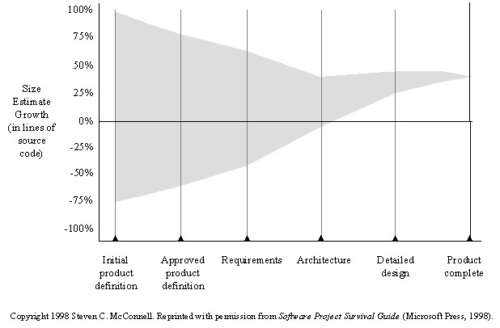
Cone of Uncertainty

Slide 7
Size Estimation
Small projects (10-99 FPs), variance of 7% from post-requirements estimates
Medium (100-999 FPs), 22% variance
Large (1000-9999 FPs) 38% variance
Very large (> 10K FPs) 51% variance

Slide 8
Size Estimation Methodologies
Top-down
Bottom-up
Analogy
Expert Judgment
Parametric or Algorithmic Method
Using formulas and equations

Slide 9
Top-down Estimation
Based on overall characteristics of project
Once you have established a good overall estimate for the project, you sub-divide it down through the layers of the work breakdown structure, for example, development will be 50% of the total, testing will be 25% etc; then sub-divide development and testing into their components etc.
Advantages
Easy to calculate
Effective early on (like initial cost estimates)
Disadvantages
Some models are questionable or may not fit
Less accurate because it doesn’t look at details

Slide 10
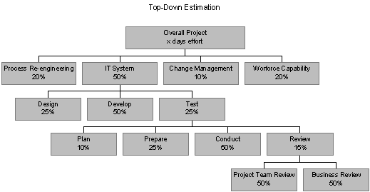
Top-down Estimation

Slide 11
Bottom-up Estimation
Create WBS
Add from the bottom-up
Advantages
Works well if activities well understood
Disadvantages
Specific activities not always known
More time consuming

Slide 12
Expert Judgment
Use somebody who has recent experience on a similar project
You get a “guesstimate”
Accuracy depends on their ‘real’ expertise
Comparable application(s) must be accurately chosen
Systematic
Can use a weighted-average of opinions

Slide 13
Estimation by Analogy
Use past project
Must be sufficiently similar (technology, type, organization)
Find comparable attributes (ex: # of inputs/outputs)
Can create a function
Advantages
Based on actual historical data
Disadvantages
Difficulty ‘matching’ project types
Prior data may have been mis-measured
How to measure differences – no two exactly same

Slide 14
Algorithmic Measures
Lines of Code (LOC)
Function points
Feature points or object points
Other possible
Number of bubbles on a DFD
Number of of ERD entities
Number of processes on a structure chart
LOC and function points most common
(of the algorithmic approaches)
Majority of projects use none of the above

Slide 15
Code-based Estimates
LOC Advantages
Commonly understood metric
Permits specific comparison
Actuals easily measured
LOC Disadvantages
Difficult to estimate early in cycle
Counts vary by language
Many costs not considered (ex: requirements)
Programmers may be rewarded based on this
Can use: # defects/# LOC
Code generators produce excess code

Slide 16
LOC Estimate Issues
How do you know how many in advance?
What about different languages?
What about programmer style?
Stat: avg. programmer productivity: 3,000 LOC/yr
Most algorithmic approaches are more effective after requirements (or have to be after)

Slide 17
Function Points
Software size is measured by number & complexity of functions it performs
Functionality can be identified from the scope and initial high-level design of the solution.
More methodical than LOC counts
House analogy
House’s Square Feet ~= Software LOC
# Bedrooms & Baths ~= Function points
Former is size only, latter is size & function

Slide 18
Function Point Process
1. Count # of functions per category
Categories: outputs, inputs, db inquiries, files or data structures, and interfaces
2. Establish Complexity Factor for each and apply
Simple, Average, Complex
Set a weighting multiplier for each (0->15)
This results in the “unadjusted function-point total”
3. Compute an “influence multiplier” and apply
It ranges from 0.65 to 1.35; is based on 14 factors
4. Results in “function point total”
This can be used in comparative estimates

Slide 19
Number of Function Points
Number of function points are based on the number and complexity of each of the following items:
Inputs — Screens, forms, dialog boxes, controls, or messages
Outputs — Screens, reports, graphs, or messages
Inquiries — Input/output combinations
Logical internal files — Major logical groups of end-user data or control information
External interface files— Files controlled by other programs

Slide 20
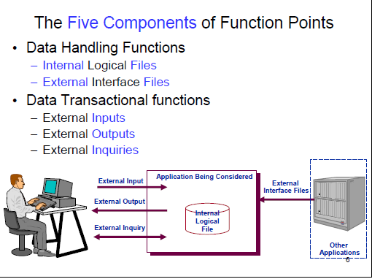

Slide 21
Advantages of Function Point Analysis
Can be applied early in the life cycle
Independent of language and technology
Provide a reliable relationship to effort
Can be used as a productivity goal
Users understand better
Provide a mechanism to track and monitor scope
Environmental factors are considered

Slide 22
Disadvantages of Function Point Analysis
Requires subjective evaluations
Results depend on technology used to implement the analysis
Many effort and cost models depend on LOC, must be converted
Best after the creation of a design specification
Not good to non-MIS applications

Slide 23
Wideband Delphi
Group consensus approach
Rand corp. used orig. Delphi approach to predict future technologies
Present experts with a problem and response form
Conduct group discussion, collect anonymous opinions, then feedback
Uses experience of several people to reach an estimate
Conduct another discussion & iterate until consensus
Advantages
Easy, inexpensive, utilizes expertise of several people
Does not require historical data
Disadvantages
Difficult to repeat
May fail to reach consensus, reach wrong one, or all may have same bias

Slide 24
Parametric Method Issues
Remember: most projects you’ll run into don’t use these
Which is ‘normal’, so don’t be surprised
Or come-in to new job and say “Hey, let’s use COCOMO”
These are more effective on large projects
Where a past historical base exists
Primary issue for most projects are
Lack of similar projects
Thus lack of comparable data

Slide 25
Code Reuse & Estimation
Does not come for free
Code types: New, Modified, Reused
If code is more than 50% modified, it’s “new”
Reuse factors have wide range
Reused code takes 30% effort of new
Modified is 60% of new
Integration effort with reused code almost as expensive as with new code

Slide 26
Effort Estimation

Slide 27
Effort Estimation
Now that you know the “size”, determine the “effort” needed to build it
Various models: empirical, mathematical, subjective
Expressed in units of duration
Man-months (or ‘staff-months’ now)

Slide 28
Effort Estimation
McConnell shows schedule tables for conversion of size to effort
As with parametric size estimation, these techniques perform better with historical data
Again, not seen in ‘average’ projects
Often the size and effort estimation steps are combined (not that this is recommended, but is what often is done)
“Commitment-Based” Scheduling is what is often done
Ask developer to ‘commit’ to an estimate (his or her own)

Slide 29
COCOMO
COnstructive COst MOdel
Allows for the type of application, size, and “Cost Drivers”
Outputs in Person Months
Cost drivers using High/Med/Low & include
Motivation
Ability of team
Application experience
Biggest weakness?
Requires input of a product size estimate in LOC

Slide 30
The COCOMO Model
Model 1: Basic COCOMO
computes software development effort and cost as a function of program size expressed in estimated LOCs.
Model 2: Intermediate COCMO
computes software development effort and cost as function of program size and a set of Cost drivers that include subjective assessment of product hardware, personnel and project attributes.
Model 3: Advanced COCOMO
incorporates all characteristics of the intermediate version with an assessment of the cost driver’s impact on each step (analysis, design, etc) of software engineering process.

Slide 31
COCOMO Modes
Organic Mode
A small team of experienced developers in a very familiar development environment
Size of software is small 1KDSI to 50 KDSI
There are very few quality constraints
Semi-detached Mode
An intermediate (in size and complexity) software project
a team with mixed experience levels
Embedded Mode
Software is required to run under tight (and strongly coupled) hardware, software and operational constraints (e.g. flight control software for aircraft)
Size is between 100 KDSI to 500 KDSI
Development team has not worked together before and development environment is not familiar to them

Slide 32
COCOMO Basics
Effort = (Personnel) (Environment)(Quality)(Size Process)
Basic Equation for COCOMO
Effort (PM) = A * Size^{B}
Time(TDev) = C * PM^{D}
Productivity = KDSI/PM
Average Staffing = PM/TDev
System Type | A | B | C | D
Organic | 2.4 | 1.05 | 2.5 | 0.38
Semi-detached | 3.0 | 1.12 | 2.5 | 0.35
Embedded | 3.6 | 1.20 | 2.5 | 0.32

Slide 33
COCOMO Intermediate
The intermediate COCOMO Model includes the effect of 15 factors (cost drivers)
Cost Drivers are multipliers for nominal cost
Effort Adjusted (PM actual) = PM(nominal) * EAF
Nominal Cost equations are
Effort (PM) = A * Size^{B}
Time(TDev) = C * PM^{D}
Cost Drivers categories
Product attributes
Computer attributes
Personnel attributes
Project attributes

Slide 34
COCOMO Cost Drivers
Product attributes
RELY: Software Reliability
DATA: Database Size
CPLX: Product Complexity
Computer attributes
TIME: Execution Time Constraints
STOR: Main Storage Constraints
VIRT: Virtual Machine Volatility
TURN: Computer Turnaround Time

Slide 35
COCOMO Cost Drivers
Personnel attributes
ACAP: Analyst Capability
AEXP: Application Experience of team
PCAP: Programmer Capability
VEXP: Virtual Machine Experience
LEXP: Programming Language Experience
Project attributes
MODP: Modern Programming Practices
TOOL: Use of Tools
SCED: Schedule Constraints

Slide 36
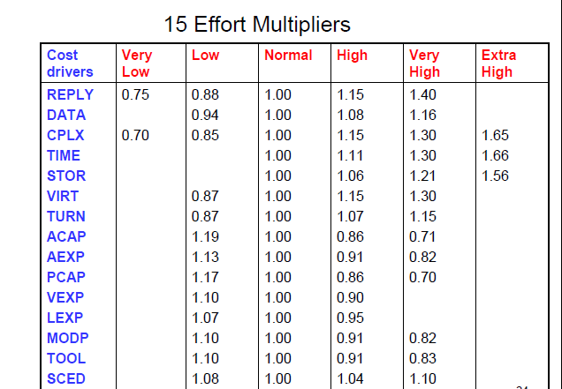
COCOMO Cost Drivers

Slide 37
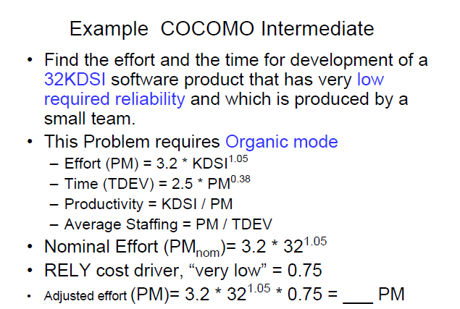

Slide 38
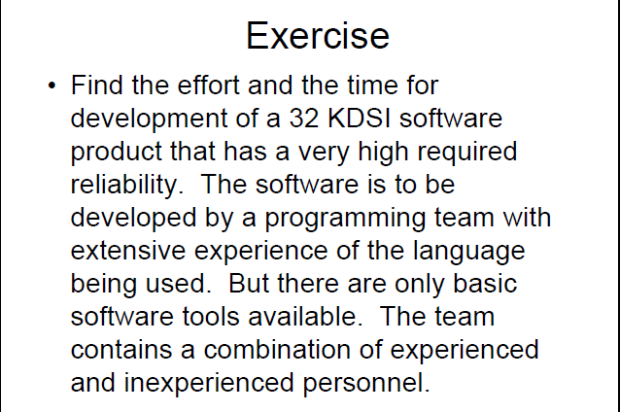

Slide 39
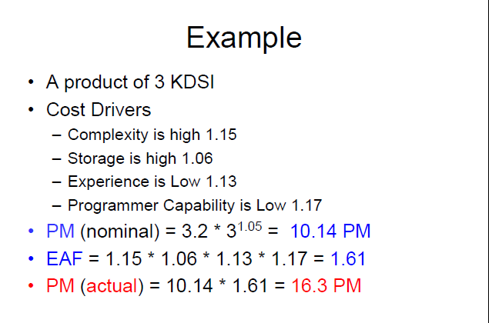

Slide 40
Estimation Issues
Quality estimations needed early but information is limited
Precise estimation data available at end but not needed
Or is it? What about the next project?
Best estimates are based on past experience
Politics of estimation:
You may anticipate a “cut” by upper management
For many software projects there is little or none
Technologies change
Historical data unavailable
Wide variance in project experiences/types
Subjective nature of software estimation

Slide 41
Over and Under Estimation
Over estimation issues
The project will not be funded
Conservative estimates guaranteeing 100% success may mean funding probability of zero.
Parkinson’s Law: Work expands to take the time allowed
Danger of feature and scope creep
Be aware of “double-padding”: team member + manager
Under estimation issues
Quality issues (short changing key phases like testing)
Inability to meet deadlines
Morale and other team motivation issues

Slide 42
Estimation Guidelines
Estimate iteratively!
Process of gradual refinement
Make your best estimates at each planning stage
Refine estimates and adjust plans iteratively
Plans and decisions can be refined in response
Balance: too many revisions vs. too few

Slide 43
Know Your Deadlines
Are they ‘Real Deadlines’?
Tied to an external event
Have to be met for project to be a success
Ex: end of financial year, contractual deadline, Y2K
Or ‘Artificial Deadlines’?
Set by arbitrary authority
May have some flexibility (if pushed)

Slide 44
Estimation “Presentation”
How you present the estimation can have huge impact
Techniques
Plus-or-minus qualifiers
6 months +/-1 month
Ranges
6-8 months
Risk Quantification
+/- with added information
+1 month of new tools not working as expected
-2 weeks for less delay in hiring new developers
Cases
Best / Planned / Current / Worst cases
Confidence Factors
April 1 – 10% probability, July 1 – 50%, etc.

Slide 45
Other Estimation Factors
Account for resource experience or skill
Up to a point
Often needed more on the “low” end, such as for a new or junior person
Allow for “non-project” time & common tasks
Meetings, phone calls, web surfing, sick days
There are commercial ‘estimation tools’ available
They typically require configuration based on past data

Slide 46
Financial Analysis of Projects

Slide 47
Financial Analysis of Projects
Financial considerations are often an important consideration in selecting projects
Three primary methods for determining the projected financial value of projects:
Net present value (NPV) analysis
Return on investment (ROI)
Payback analysis

Slide 48
Net Present Value Analysis: NPV
NPV: a method of calculating the expected net monetary gain or loss from a project by discounting all expected future cash inflows and outflows to the present point in time
NPV is the present value of the benefits minus the value of initial investment
Projects with a positive NPV should be considered if financial value is a key criterion
The higher the NPV, the better

Slide 49
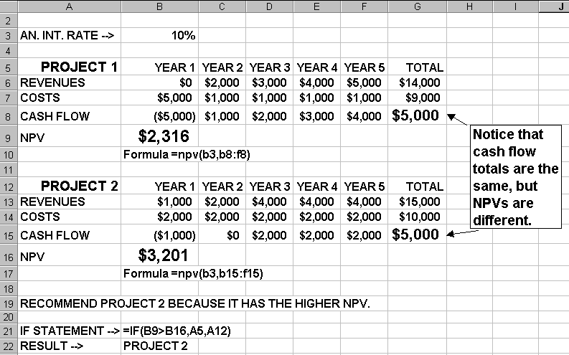
NPV Example

Slide 50
Return on Investment (ROI)
ROI: income divided by investment
ROI = (total discounted benefits - total discounted costs) / discounted costs
The higher the ROI, the better
Many organizations have a required rate of return or minimum acceptable rate of return on investment for projects

Slide 51
Payback Analysis
Another important financial consideration is payback analysis
The “payback period” is the amount of time it will take to recoup, in the form of net cash inflows, the net dollars invested in a project
Payback occurs when the cumulative discounted benefits and costs are greater than zero
Many organizations want IT projects to have a fairly short payback period

Slide 52
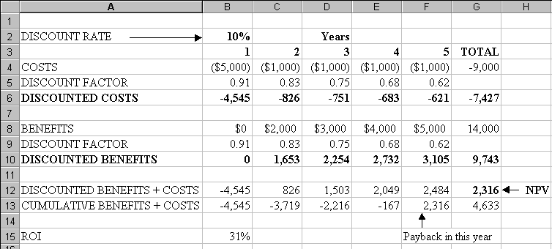
NPV, ROI, Payback Period: Ex 1

Slide 53
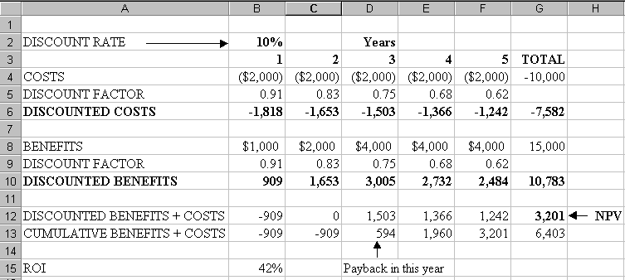
NPV, ROI, Payback Period: Ex 2

Slide 54
Weighted Scoring Model
A weighted scoring model is a tool that provides a systematic process for selecting projects based on many criteria
First identify criteria important to the project selection process
Then assign weights (percentages) to each criterion so they add up to 100%
Then assign scores to each criterion for each project
Multiply scores * weights = total weighted scores
The higher the weighted score, the better

Slide 55
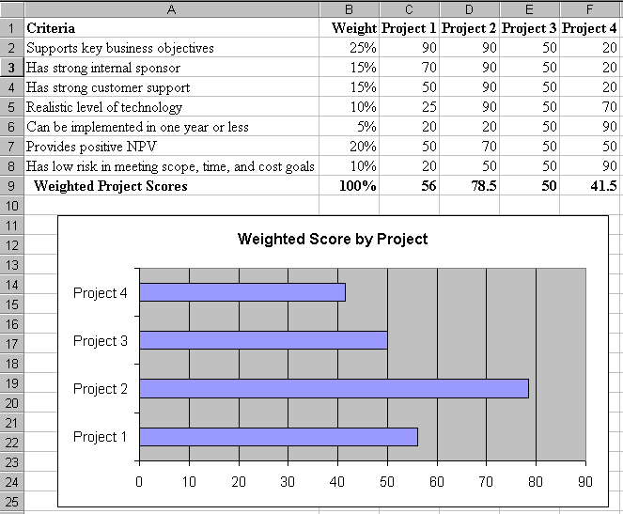
Sample Weighted Scoring Model

